Slide 1
Microsoft Dynamics AX 2012 Administration Workshop Chapter 4: Manage Database Logging
Presenter Name
Presenter Title
Presenter Company

Slide 2
Conditions and Terms of Use
Microsoft Confidential
This training package is proprietary and confidential, and is intended only for uses described in the training materials. Content and software is provided to you under a Non-Disclosure Agreement and cannot be distributed. Copying or disclosing all or any portion of the content and/or software included in such packages is strictly prohibited.
The contents of this package are for informational and training purposes only and are provided "as is" without warranty of any kind, whether express or implied, including but not limited to the implied warranties of merchantability, fitness for a particular purpose, and non-infringement.
Training package content, including URLs and other Internet Web site references, is subject to change without notice. Because Microsoft must respond to changing market conditions, the content should not be interpreted to be a commitment on the part of Microsoft, and Microsoft cannot guarantee the accuracy of any information presented after the date of publication. Unless otherwise noted, the companies, organizations, products, domain names, e-mail addresses, logos, people, places, and events depicted herein are fictitious, and no association with any real company, organization, product, domain name, e-mail address, logo, person, place, or event is intended or should be inferred.
Copyright and Trademarks
© 2013 Microsoft Corporation. All rights reserved.
Microsoft may have patents, patent applications, trademarks, copyrights, or other intellectual property rights covering subject matter in this document. Except as expressly provided in written license agreement from Microsoft, the furnishing of this document does not give you any license to these patents, trademarks, copyrights, or other intellectual property.
Complying with all applicable copyright laws is the responsibility of the user. Without limiting the rights under copyright, no part of this document may be reproduced, stored in or introduced into a retrieval system, or transmitted in any form or by any means (electronic, mechanical, photocopying, recording, or otherwise), or for any purpose, without the express written permission of Microsoft Corporation.
For more information, see Use of Microsoft Copyrighted Content at http://www.microsoft.com/about/legal/permissions/
Microsoft®, Hyper-V®, Microsoft Dynamics®, SQL Server®, and Windows® are either registered trademarks or trademarks of Microsoft Corporation in the United States and/or other countries. Other Microsoft products mentioned herein may be either registered trademarks or trademarks of Microsoft Corporation in the United States and/or other countries. All other trademarks are property of their respective owners.

Slide 3
Students: How to View this Presentation
Switch to Notes Page view
Click View on the ribbon and select Notes Page
Use page up or page down to navigate
Zoom in or out as needed
Most slides will have supporting text that you can view now or after the delivery
Add notes to your copy of the presentation if you want to
You take the presentation files home with you.

Slide 4
Overview
Database Logging
Track changes to tables and fields
Create audit trails
Monitor use of electronic signatures
By default, all transactions that have been signed with electronic signatures are logged
Note: Database logging is intended to track single transactions. It is not intended for tracking automated transactions running in batch jobs.
Notes:
Note: In this chapter, you will use FULL TRAINING COURSE IMAGE to complete the procedures and labs, unless otherwise noted.

Slide 5
Objective
Understand database logging:
Security concerns
Performance implications
Set up
Log cleanup

Slide 6
Security
Database logs can contain sensitive data
To protect data, restrict permissions on the SYSDATABASELOG table

Slide 7
Performance
Each instance of a logged transaction causes multiple records to be written to SQL Server
Logging will downgrade set-based operations to row-based operations
Database logging can adversely affect long-running automated processes, such as inventory close, BOM calculations, master planning, and long-running data imports
The database log table can grow quickly

Slide 8
Planning
How long will you retain logged data?
How will you remove old logs from the system?
Who will be reviewing logged data?
Limit log entries by selecting specific fields to log instead of whole tables.
Notes:
Note: Only updates can be logged for individual fields.

Slide 9
Set Up Database Logging
Scenario: You would like to log updates to customer credit limits.
Procedure: Set Up Database Logging Set up the system to log updates to the Credit limit field for a Customer record.
Notes:
Procedure: Set Up Database Logging
In this procedure, you will set up the system to log updates to the Credit limit field for a Customer record.
Click System administration > Setup > Database > Database log setup.
Click New to start the Logging database changes wizard, and then click Next again.
Select Show main tables.
Expand General ledger.
Expand Customers.
Select the CreditMax field, and then click Next.
On the Types of change form, select Update.
Click Next, and then click Finish.

Slide 10
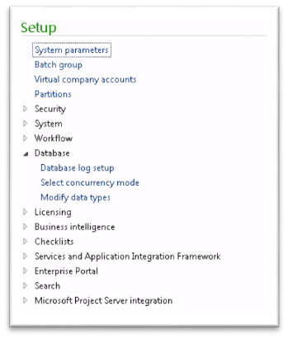
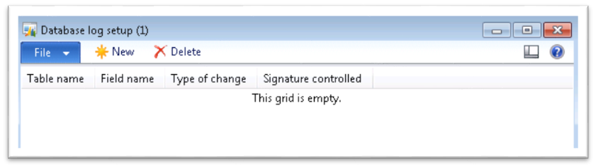
Set Up Database Logging
Click System administration > Setup > Database log setup.
Click New to start the Logging database changes wizard.

Slide 11
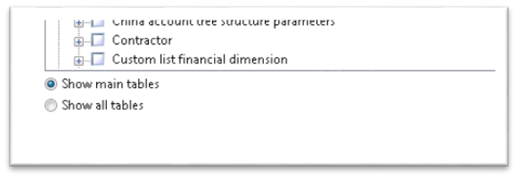
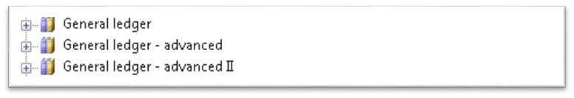

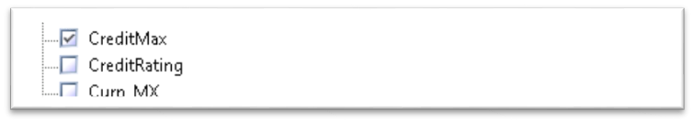
Set Up Database Logging
Select Show main tables.
Expand General ledger.
Expand Customers.
Select CreditMax.
Notes:
How did you find the table, module, and field to be set up for database logging?

Slide 12
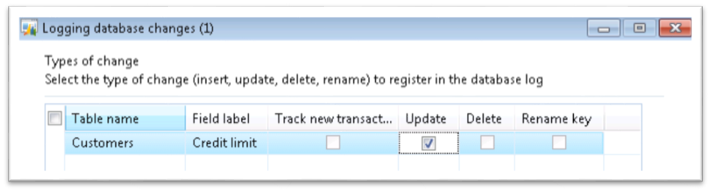
Set Up Database Logging
Click Next.
On the Types of change form, select the Update check box.
Click Next.
Click Finish, and then click the Close button.
Notes:
Recreate the steps again from your Hyper-V computer.

Slide 13
Create and View Database Log Records
Procedure: Create a database log record Update a customer credit limit to trigger a log record
Procedure: View the database log record Review the transaction recorded in the database log
Notes:
Procedure: Create Database Log Record
In this procedure, you will update a customer credit limit to create a log record.
Open Accounts receivable > Customers > All Customers.
Select the first customer in the list.
Click Edit.
Under Credit and collections, change the Credit limit amount.
Close the form to save the changes automatically.
Procedure: View Database Log Record
In this procedure, you will view the database record that you created in the previous procedure.
Open System administration > Inquiries > Database > Database log. A new record should have been added.
The Overview tab provides the Record identification, which, in this case, gives the customer account number and RecID of the record that was logged.
Click the History tab to see the values that changed for the selected record.
View the contents of the changes.

Slide 14
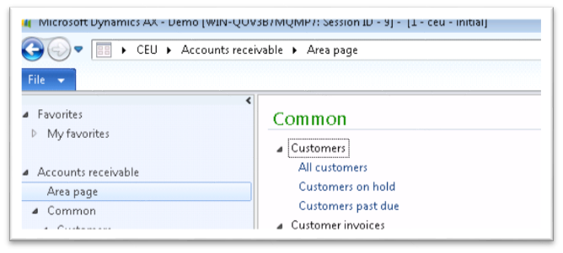
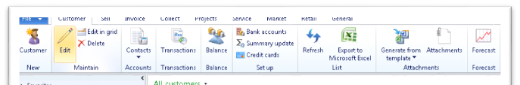
Create Database Log Records
Open Accounts receivable, click Customers, and then click All Customers.
Select the first customer in the list.
On the ribbon, click Edit.

Slide 15
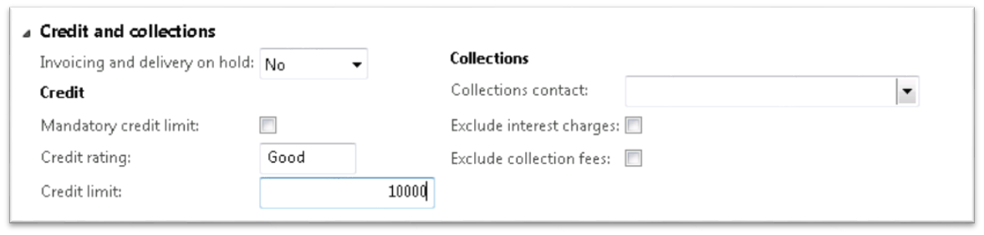
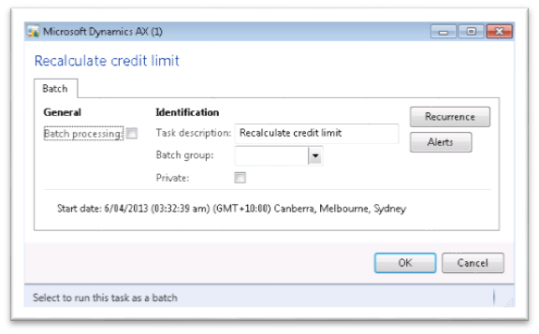
Create Database Log Records
Under Credit and collections, change the Credit limit amount to 10,000.
Close the form to automatically save the changes. If the Recalculate credit limit window appears, click OK to run and commit the changes.
Notes:
Open the form again to see that the credit limit has been updated to “10,000.”

Slide 16
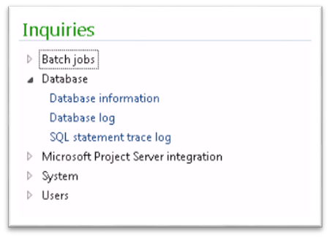
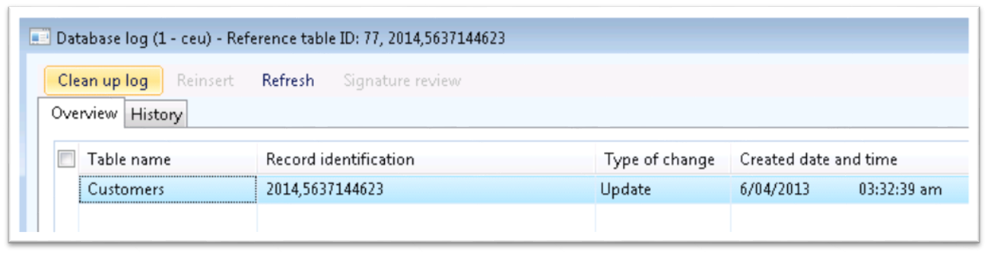
View Database Log Records
Open System administration > Inquiries > Database > Database log.
A new record should have been added.

Slide 17
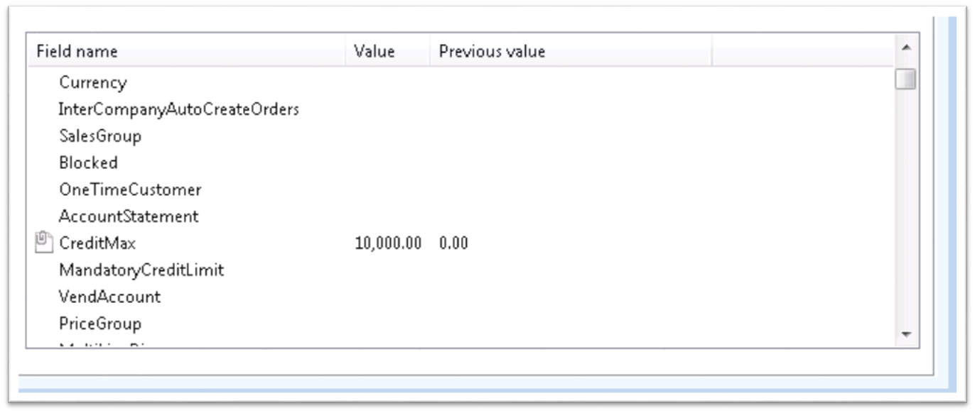
View Database Log Records
Click the History tab.
View the contents of the changes.

Slide 18
Database Log Cleanup
Scenario: You need to periodically clean up the database log information that is no longer needed for audit purposes.
Procedure: Clean up Database Logs You can delete database logs. You can select all logs for a particular table, specific types of a database log, or a date and time that a log was created to delete.
Notes:
Procedure: Clean up Database Logs
In this procedure, you will clean up the database logs that are 12 months or older.
Click System administration > Inquiries > Database > Database log.
Click Clean up log.
Enter a query that is 12 months or older.
Click OK.

Slide 19
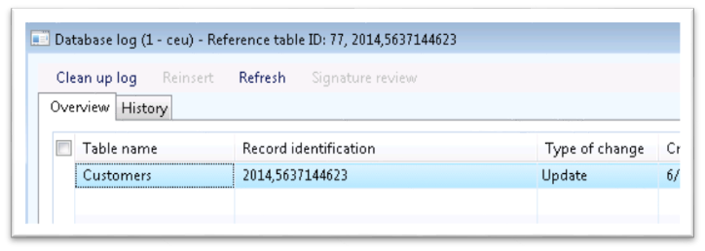
Database Log Cleanup
Click System administration > Inquiries > Database > Database log.
Click the Clean up log menu.

Slide 20
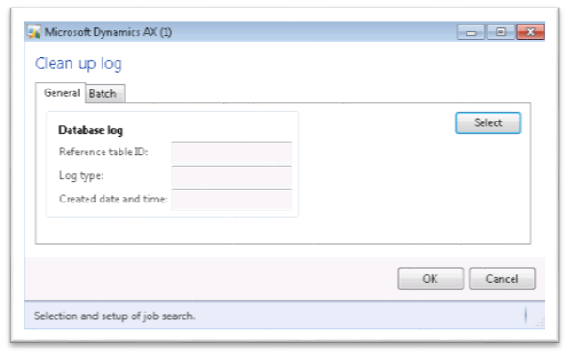
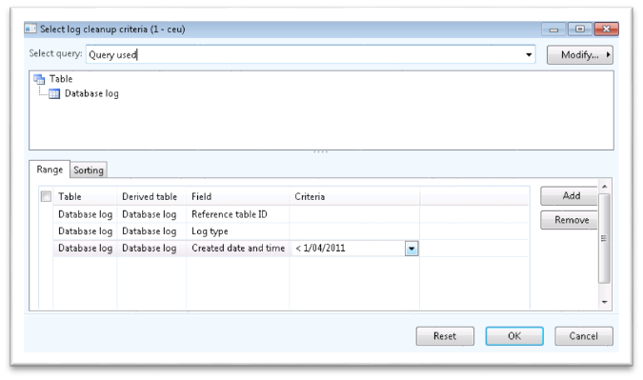
Database Log Cleanup
Click the Select button in the Clean up log.
Enter a query that is 12 months or older.

Slide 21
Test Your Knowledge
The class will complete this section

Slide 22
Chapter Review
Changes that can be tracked on tables includes (click all that apply)?
( ) Inserts
( ) Updates
( ) Deletes
( ) Rename key
True or False? Database logging is intended to track single transactions not automated transactions running in batch jobs.
( ) True
( ) False

Slide 23
Chapter Review (Answers)
Changes that can be tracked on tables includes (click all that apply)?
(X) Inserts
(X) Updates
(X) Deletes
(X) Rename key
True or False? Database logging is intended to track single transactions not automated transactions running in batch jobs.
(X) True
( ) False

Slide 24
Chapter Summary
In this chapter, we covered the following topics:
An overview of the database logging system
Security concerns with sensitive data
Performance implications of database logging
Setting up database logging
Cleaning up database log records

